Slide 1
How to manage costs and size services in Microsoft Azure, what to do and what to avoid?
William Eastbury
Technical Evangelist

Slide 2
Introduction and Housekeeping Welcome to Microsoft UK, 2 Kingdom Street
Notes:
Any of them will run on Virtual Machines, Azure is simply a deployment switch.

Slide 3
Housekeeping
Fire Alarms
Emergency Exits
Toilets
Lunch and Dietary Requirements
Feedback forms and today’s website http://aka.ms/azurevipevent (code = 901031)
E&OE on pricing.
Group Discussion and 1-2-1 Office Hours
Notes:
E&OE on pricing = some prices are rounded and calculated on specific regions, should be correct as at 31/01/2017… for the UK South Region.

Slide 4
Today’s Agenda
Introduction and Housekeeping
What to do (Cloud Design Patterns and good practices) and what to avoid (Classic errors and mistakes)
Coffee
Demos and Tooling
Lunch
Afternoon - Multiple Tracks (Chalk ’n’ Talks, Office Hours)

Slide 5
The Q&A Process
Please note down questions and post them on the event site, we will use them to drive the content of the interactive group discussion later.
Nothing is a stupid question, please ask away !
Site is @ http://aka.ms/azurevipevent
Security Code is: 901031

Slide 6
Today’s Brief.
How you can control your Azure Cloud based services cost profile, whilst allowing your software and data to scale as and when you need it.
How do we predict workloads and frequency?
How do we allow for sudden demand without committing unnecessary costs?

Slide 7
The ‘Brief’ answers
How you can control your Azure Cloud based services cost profile, whilst allowing your software and data to scale as and when you need it. – Pricing Models and Tips
How do we predict workloads and frequency? Telemetry and Load Testing
How do we allow for sudden demand without committing unnecessary costs? – Queuing, Autoscaling and load balancing

Slide 8
The Other Questions
How do ISV’s build cloud solutions on the Azure platform for a predictable and commercially reasonable cost?
Or: How much will it cost ?
And: How much will we make (in margin)?
And: How much will we need to build / invest?

Slide 9
Architecture and Services What types of application will run in Azure?
Notes:
Any of them will run on Virtual Machines, Azure is simply a deployment switch.

Slide 10





Software: Architectural Types
Program Executable
Client Application
Load Balancer
User Interface
Business Logic
Data
Front End
(Stateless Web)
Backing Store
Server (Service and / or Relational DB)
Stateless
Middle-tier
Compute
Queues Storage
Microservices,
Cloud Scale,
Distributed and Replicated State
XML,
Web Services,
n-tier apps,
HA and Disaster Recovery
C-ISAM,
Monolithic applications
RDBMS,
Client-Server
1. 1960s to 1970s
2. 1980s to 1990s
3. 1990s to 2000s
4. 2000s to Now()
Notes:
Life as a developer was more easy a couple years ago: write code, ship a new version every 2 years and then the cycle began again.
We are used to build what we call 3 tiers architectures with these tiers usually tightly coupled with maintenance windows over the week end so we can patch all the tiers together in one shot.
With the cloud everything changed, not only are the dev teams now responsible to build application features but they need to make sure that the code they write is scalable and runs reliably, that their services are always available, run efficiently with the best performance and lowest latency – all of the time being mindful of delivery at the lowest COS / COGS or Cost of Service.
At the same time architecture we used to build services has changed in the cloud world, todays services are global, and need to be hot-patched as those maintenance windows are no longer allowed.

Slide 11
Software: Architectural Types
Monolithic “Big ball of mud”, no internal layering.
Virtual Machines (IaaS)
Monolithically Compiled App, multi-layered design with class separation between layers.
Virtual Machines (IaaS), App Service
N-tier designed app, with physical separation between tiers.
Virtual Machines (IaaS), App Service, Service Fabric
Micro-services architecture.
App Service, Service Fabric, Azure Functions

Slide 12
Tenancy Models
Single Tenant Deployment
Manual Deployment and Build (Pets)
Multiple Single Tenant Deployments (templated)
ARM Templated deployment (Cattle)
Multi-Tenant App, with a data-tier tenant key used to isolate tenants in a database
ARM Templated deployment (Cattle)
Multi-Tenant App, with multiple data services / databases
ARM Templated deployment (Cattle)
Multi-Tenant App, with multiple data services / databases, with clustering and balancing of services across scale units
ARM Templated deployment / Service Fabric (Cattle)
Notes:
There is a schema-versioned instance of the multi-tenant app as well, but I’m going to ignore it here.

Slide 13
Cost Design, Architecting and Deploying for Efficiency Predictability of cost and scaling appropriately

Slide 14
Patterns and practices What types of things can we do to balance cost and performance?
Notes:
Let’s look at some patterns and practices that can be used to mitigate the cost of building high-performance solutions.
How can you ensure maximum performance and scalability for a commercially reasonable Cost of Service?

Slide 15
Content Delivery Networks (And/or the “Static content hosting pattern”) Why waste CPU and Memory rendering something that could be served by someone else’s resources? Caching Storage is usually significantly cheaper than compute used to generate a resource each time. Azure offers integrated use of TWO CDN providers (both Akamai and Verizon CDN services) through Azure CDN. Either generate the content in advance and store it for retrieval (for example in Azure Blob Storage) or use a CDN to cache that data in an Edge network endpoint. These services are not just of use for web apps, they can help with metadata distribution over high latency far-flung WANs as well (Suppose you have users that access a central, slowly changing file resource in Australia).
Notes:
There are a few versions and subtle differences to this pattern.
CDN caching of the whole site – works well for relatively static sites
Output Caching via Redis / files – works well for sites that take a lot of CPU to generate output
Pre-Generated output of the whole site, this works if you are generating really media intensive sites.
Storage is usually cheaper than compute.

Slide 16
Demo: Azure CDN
Content Delivery
Network (CDN)
Let’s connect an app to a CDN endpoint to serve resources faster and more cheaply than we can.

Slide 17
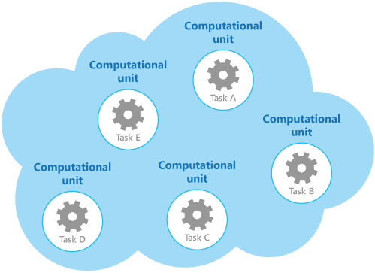
“Compute Resource Consolidation”
So we follow the design principle of separation of concerns, and divide these operations into discrete computational units that are hosted and deployed individually (for example, as separate roles in a Microsoft Azure Cloud Service, separate Azure Web Sites, or separate Virtual Machines).
Use this pattern for tasks that are not cost effective if they run in their own computational units.
If a task spends much of its time idle, running this task in a dedicated unit can be expensive.
This pattern might not be suitable for tasks that perform critical fault-tolerant operations, or tasks that process highly-sensitive or private data and require their own security context
http://aka.ms/compute-resource-consolidation-pattern
However, although this strategy can help to simplify the logical design of the solution, deploying a large number of computational units as part of the same application can increase runtime hosting costs and make management of the system more complex.
Notes:
Consolidate multiple services and tenants into one service hosting footprint to consume spare resource.
Consider App Service Hosting Plans
Virtual Machines and Containers
Service Fabric and Microservices
This pattern works well where you have lots of ‘small’ services that will under-consume even the smallest of single servers.
e.g. microservices, lots of small tenant apps, clusters of n-tier apps

Slide 18
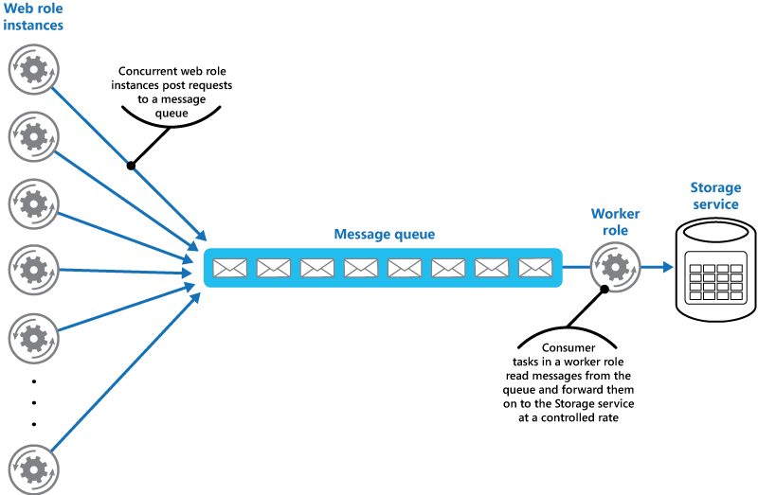
“Queue Based Load Leveling”
Use where there is a highly variable load pattern and idle periods to ‘smooth’ out the peaks in load.
Use as a precursor to enable the competing consumers (autoscaling) pattern.
https://aka.ms/queue-based-load-leveling-pattern
Notes:
Developer Pattern: Push Inserts through Queue with a single consumer and allow a grace period to
// Talk about queue pattern.
Asynchronous, so return a 202 – Accepted http message, not a 200 – Success message
CAN Expose a query function url separately for the result (blob endpoint)
Eventually bottleneck will be 24 hr operation of a maximum sized queue consumer.

Slide 19
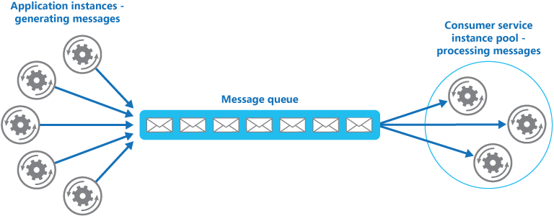
“Competing Consumers”
Scaling out via queues: when our queue consumer becomes a bottleneck, simply run more instances of the consumer.
If you are really slick, then auto scale instances based on the Queue’s Length – if it starts to back up, then add more capacity until the backlog is resolved, then scale down.
Azure Functions allows you to scale compute resource like this by default and makes it trivial to consume a queue in a massively scalable manner.
https://aka.ms/competing-consumers-pattern
Notes:
This is already implemented for us for free as we are using functions, if we simply choose a hosting plan with multiple cores or instances then webjobs / functions will run it flat out.

Slide 20
“Scale out, not up”: Scale Units and Stamps
Azure’s infrastructure is deployed in groups of identical servers, not individually.
Consider the impact on operating your service if: instead of scaling like this …
1x D1V2 instance supports 500 users @~£90
1x D2V2 instance supports 1000 users @~£180
1x D3V2 instance supports 2000 users @~£360
1x D4V2 instance supports 4000 users @~£720
1x D5V2 instance supports 8000 users @~£1440
Notes:
At the opposite end of the scale we have the scenario where one server, or service deployment is not large enough for your entire service.
In this scenario we can break the service apart into multiple ‘units of scale’, or ‘stamps’, this reduces the size of the hosted service and can allow you to ‘home’ a tenant, or part of a tenant (in a multi-tenant scenario) onto it’s own instance of a service.
Minimise ‘global’ services as they are difficult to predict and scale.

Slide 21
Scale Units and Deployment Stamps
Scale like this …
1x Stamp of 1X D1V2
Can support 500 users @ ~£90
1x Stamp of 2X D1V2
Can support 1000 users @ ~£180
1x Stamp of 3x D1V2 Can support 1500 users @ ~£270
1x Stamp of 4x D1V2 Can support 2000 users @ ~£360
1x Stamp of 5x D1V2 Can support 2500 users @ ~£450
1x Stamp of 6x D1V2 Can support 3000 users @ ~£540
1x Stamp of 7x D1V2 Can support 3500 users @ ~£630
1x Stamp of 8x D1V2 Can support 4000 users @ ~£720
If the biggest component of your service cost is compute costs, not 3p software licencing then this will make sense for you as it adds additional levels of granularity into your pricing.
Notes:
At the opposite end of the scale we have the scenario where one server, or service deployment is not large enough for your entire service.
In this scenario we can break the service apart into multiple ‘units of scale’, or ‘stamps’, this reduces the size of the hosted service and can allow you to ‘home’ a tenant, or part of a tenant (in a multi-tenant scenario) onto it’s own instance of a service.
Minimise ‘global’ services as they are difficult to predict and scale.
These scale units, want to be as small as you can make them, and you want to be able to increase capacity by adding more of them
Consider load-balancers and geo-distribution of services
Stateless services scale automatically across nodes, stateful services need some intervention.
(Common Caches, and sticky sessions, synchronous data replication)

Slide 22
Scale Units and Deployment Stamps
When not even one stamp is enough ….
1x Stamp of 50x D1V2 Can support 25,000 users @ ~£4,500
2x Stamps of 50x D1V2 Can support 25,000 users @ ~£9,000
1x Stamp of 1X D1V2
Can support 500 users @ ~£90
1x Stamp of 2X D1V2
Can support 1000 users @ ~£180
4x Stamps of 50x D1V2 Can support 50,000 users @ ~£13,500
8x Stamps of 50x D1V2 Can support 100,000 users @ ~£18,000
1x Stamp of 3x D1V2 Can support 1500 users @ ~£270
1x Stamp of 4x D1V2 Can support 2000 users @ ~£360
1x Stamp of 5x D1V2 Can support 2500 users @ ~£450
1x Stamp of 6x D1V2 Can support 3000 users @ ~£540
1x Stamp of 7x D1V2 Can support 3500 users @ ~£630
1x Stamp of 8x D1V2 Can support 4000 users @ ~£720
If the biggest component of your service cost is compute costs, not 3p software licencing then this will make sense for you as it adds additional levels of granularity into your pricing.
Notes:
At the opposite end of the scale we have the scenario where one server, or service deployment is not large enough for your entire service.
In this scenario we can break the service apart into multiple ‘units of scale’, or ‘stamps’, this reduces the size of the hosted service and can allow you to ‘home’ a tenant, or part of a tenant (in a multi-tenant scenario) onto it’s own instance of a service.
Minimise ‘global’ services as they are difficult to predict and scale.
These scale units, want to be as small as you can make them, and you want to be able to increase capacity by adding more of them
Consider load-balancers and geo-distribution of services
Stateless services scale automatically across nodes, stateful services need some intervention.
(Common Caches, and sticky sessions, synchronous data replication)

Slide 23
Scale Units and Deployment Stamps
We can represent that in this way with autoscaling …
1x Auto Scaling Stamp
From 1X D1V2 - To 8x D1V2
Can support between 500 and 4000 users @ ~£90 - ~£720 per month
2x Auto Scaling Stamp
From 1X D1V2 - To 8x D1V2
Can support between 1000 and 8000 users @ ~£180 - ~£1,440 per month
But if we are smart about how we balance traffic and manage session state, then we get to this.
1 or 2 Auto Scaling Stamps
From 1-2 x ( 1x D1V2 - To 100x D1V2)
Can support between 500 and 50000 users @ ~£90 - ~£9,000 per month
Notes:
At the opposite end of the scale we have the scenario where one server, or service deployment is not large enough for your entire service.
In this scenario we can break the service apart into multiple ‘units of scale’, or ‘stamps’, this reduces the size of the hosted service and can allow you to ‘home’ a tenant, or part of a tenant (in a multi-tenant scenario) onto it’s own instance of a service.
Minimise ‘global’ services as they are difficult to predict and scale.
These scale units, want to be as small as you can make them, and you want to be able to increase capacity by adding more of them
Consider load-balancers and geo-distribution of services
Stateless services scale automatically across nodes, stateful services need some intervention.
(Common Caches, and sticky sessions, synchronous data replication)

Slide 24
Scale Units and Deployment Stamps
Single Server
Stamps / Scale Units + Autoscaling out
Q: A 10 user system costs how much to run in this model ?
Q: A 1000 user tenant costs how much to run ?
Q: A 35,000 user tenant costs how much to run ?
Notes:
At the opposite end of the scale we have the scenario where one server, or service deployment is not large enough for your entire service.
In this scenario we can break the service apart into multiple ‘units of scale’, or ‘stamps’, this reduces the size of the hosted service and can allow you to ‘home’ a tenant, or part of a tenant (in a multi-tenant scenario) onto it’s own instance of a service.
Minimise ‘global’ services as they are difficult to predict and scale.
These scale units, want to be as small as you can make them, and you want to be able to increase capacity by adding more of them
Consider load-balancers and geo-distribution of services
Stateless services scale automatically across nodes, stateful services need some intervention.
(Common Caches, and sticky sessions, synchronous data replication)

Slide 25
Scale Units and Deployment Stamps
Single Server (Scale Up)
Stamps / Scale Units + Autoscaling out
Q: A 10 user system costs how much to run in this model ?
Q: A 1000 user tenant costs how much to run ?
Q: A 35,000 user tenant costs how much to run ?
Q: A 10 user system costs how much to run in this model ? ~£90 (Single instance, use the compute resource consolidation pattern to group tenants together onto hardware here, 1 single VM stamp should support 50x10 user tenants).
Q: A 1000 user tenant costs how much to run ? ~£180 (2x VM instance)
Q: A 35,000 user tenant costs how much to run ? 72 x D1v2 VM or 1x D8V2 VM ? How much are they ?
Q: A 10 user system costs how much to run in this model ? ~£90 (Single instance, use the compute resource consolidation pattern to group tenants together onto hardware here, 1 single VM stamp should support 50x10 user tenants).
Q: A 1000 user tenant costs how much to run ? ~£180 (2x VM instance)
Q: A 35,000 user tenant costs how much to run ? 72 x D1v2 VM or 3x G5 VM ? How much are they ?
Notes:
At the opposite end of the scale we have the scenario where one server, or service deployment is not large enough for your entire service.
In this scenario we can break the service apart into multiple ‘units of scale’, or ‘stamps’, this reduces the size of the hosted service and can allow you to ‘home’ a tenant, or part of a tenant (in a multi-tenant scenario) onto it’s own instance of a service.
Minimise ‘global’ services as they are difficult to predict and scale.
These scale units, want to be as small as you can make them, and you want to be able to increase capacity by adding more of them
Consider load-balancers and geo-distribution of services
Stateless services scale automatically across nodes, stateful services need some intervention.
(Common Caches, and sticky sessions, synchronous data replication)

Slide 26
Using the pricing calculator
Q: A 10 user system costs how much to run in this model ? ~£90 (Single instance, use the compute resource consolidation pattern to group tenants together onto hardware here, 1 single VM stamp should support 50x10 user tenants).
Q: A 1000 user tenant costs how much to run ? ~£180 (2x VM instance)
Q: A 35,000 user tenant costs how much to run ? 72 x D1v2 VM or 2x G5 VM ? How much are they ?
Compute only pricing (not network or storage, but those costs are trivial).
10 User tenant = 1 x D1v2 = £90.39/month / 50 = £1.80 per 10 user tenant
1000 User tenant = 2 x D1v2 = £180.77 / month = £180 per 1000 user tenant
35,000 User tenant = Either :-
72 x D1v2 = £6,507 / month / 1 = £6,507 per 1000 user tenant
3 x G5 = £18,465 / month = £18,465 per 35,000 user tenant
So you can save 2/3 on your compute costs by taking this approach if your app will chunk down.
Notes:
Lets Open :- https://azure.microsoft.com/en-us/pricing/calculator/
Add Virtual Machines
Select UK South / Windows / Standard / D1V2 : £90.39/month
Change the number to 2x D1V2 : £180.77/month
Change the number to 72 x D1V2 : £6507.73/month
Change the number to 3 x size to G5 (Switch to West Europe) : £18465/month

Slide 27
Impact of autoscaling my stamps
Lets take the 35,000 User tenant using 72 x D1v2 = £6,507 per 1000 user tenant / month
That’s peak load, you will more than likely not need 72x D1v2 servers running permanently.
What’s the idle rate and do you need to smooth out bursty demand?
Overnight do you only need 12 servers, or maybe just 2 ?
If we only run 72 servers half of the time but can autoscale up to 72 for the other half of the time then our service cost is actually.
£6,507 / month * Autoscaling Ratio of 50% = £3253.50 / month
And if we only run 2 servers overnight (A D1v2 costs £0.12 / hour) and burst up to 72 in the day for 12 hours.
((2x12)+(72*12))(*7*4.3)*(£0.12) = £454 / month
Notes:
Lets Open :- https://azure.microsoft.com/en-us/pricing/calculator/
Add Virtual Machines
Select UK South / Windows / Standard / D1V2 : £90.39/month
Change the number to 2x D1V2 : £180.77/month
Change the number to 72 x D1V2 : £6507.73/month
Change the number to 3 x size to G5 (Switch to West Europe) : £18465/month

Slide 28
Let’s just reflect on that for a moment, from £18,465/month to £454 / month !!!
Notes:
How are users using my service, what are they doing, how long does it take to run certain transactions.

Slide 29
Data Tier Scaling What about the data tier, isn’t that the hardest tier to scale?

Slide 30
Use an appropriate type of Store
Storage Mechanism | Interaction | Starts at (Avg)* | Min GB | Max TB | Use Case
Azure ‘Cool’ Block Blob storage | REST (Blob), SDKs | £0.01/GB | 0 | 500 | Archive, nearline unstructured https storage
Azure ‘Hot’ Block Blob storage | REST (Blob), SDKs | £0.02/GB | 0 | 500 | Online unstructured https storage
Azure Virtual Machine Disk / Page Blob Storage | VM Only | £0.05/GB | 0 | 500 (Not per VM) | High Performance storage, up to 500 IOPS per disk volume (up to max volumes per VM type).
Azure Table Storage | REST (Blob), SDKs | £0.07/GB | 0 | 500 | Tabular, non-relational (NoSQL) Mass-scale dictionary https lookup service, partitioned by default, no secondary indexes allowed.
Azure Premium Virtual Machine Disk/ Page Blob Storage | VM Only | £0.13/GB | 128 | 35 | GUARANTEED High Performance storage, up to 5000 IOPS per disk volume (up to max volumes per VM type > 80,000 IOPS & 2TB / Second).
Azure SQL Database Basic | T-SQL (TDS) | £2.33/GB * | 2 | 1 | Tabular, Scalable, Classic Relational DBMS, Always On
Azure SQL Data Warehouse | T-SQL (TDS) | £1.03/GB * | 1024 | ~250 Compressed (~1PB) | Scalable, Tabular, Parallelized, Relational DBMS, can be paused.
DocumentDB | REST (Blob), SDKs | £4.62/GB * | 1 | 0.01 (10GB) | JSON Indexed document storage, can be partitioned.
Azure Data Lake Store | WebHDFS | £0.06/GB * | 1024 | 1PB per file (!) | Hadoop based unstructured data storage layer. – Preview price includes 50% discount off US pricing, not available in Europe yet.
* These are indicative numbers, these numbers are variable on a number of factors. For example SQL DW starts billing at 1TB of capacity, storage has an access charge per million transactions.
Notes:
Admin / IT Pro consideration
Switch in portal. Explain each type of storage and where it is appropriate
Talk about Optimistic concurrency for blobs and containers
The Storage service assigns an identifier to every object stored. This identifier is updated every time an update operation is performed on an object. The identifier is returned to the client as part of an HTTP GET response using the ETag (entity tag) header that is defined within the HTTP protocol.
Clarify that the Performance and latency levels locally for LRS / ZRS / GRS and RA-GRS are *identical* the secondaries are written to ASYNCHRONOUSLY.

Slide 31
Use an appropriate type of Storage
Deploy
Replication strategy | LRS | ZRS | GRS | RA-GRS | Premium-LRS
Data is written synchronously to multiple nodes. | Yes | Yes | Yes | Yes | Yes
Data is replicated async across multiple facilities. | No | Yes | Yes | Yes | No
Data can be read from the secondary location as well as from the primary location. | No | No | No | Yes | No
Number of copies of data maintained on separate nodes. | 3 | 3 | 6 | 6 | 3
Number of copies of data maintained in a separate geographically paired region. | 0 | 0 | 3 | 3 | 0
Relative Cost / GB / Month (UK South – Standard List Price) | Block (Cold) £0.01 Block (Warm) £0.02 Table £0.07 Disk £0.05 | Block £0.03 Table N/A Disk N/A | Block £0.04 Table £0.09 Disk £0.09 | Block £0.06 Table £0.11 Disk £0.11 | Block N/A Table N/A Disk £0.13
Performance Tier | + | + | + | + | +++
https://azure.microsoft.com/en-us/pricing/calculator/
https://azure.microsoft.com/en-us/documentation/articles/storage-redundancy/
Notes:
Admin / IT Pro consideration
Switch in portal. Explain each type of storage and where it is appropriate
Talk about Optimistic concurrency for blobs and containers
The Storage service assigns an identifier to every object stored. This identifier is updated every time an update operation is performed on an object. The identifier is returned to the client as part of an HTTP GET response using the ETag (entity tag) header that is defined within the HTTP protocol.
Clarify that the Performance and latency levels locally for LRS / ZRS / GRS and RA-GRS are *identical* the secondaries are written to ASYNCHRONOUSLY.

Slide 32
Extreme Scaling: “Sharding” Pattern
This technique is used to partition a data store into a number of smaller horizontal partitions or shards.
This pattern can improve scalability when storing and accessing large volumes of data.
This is what you do when you hit a hard limit of scale in the data tier, effectively split the database in two.
This pattern can also be used to split services geographically and ‘home’ certain users data to a specific region for geo-political purposes.
Azure SQL Database Elastic Scale Libraries can be used to make this process easier.
Strategy | Advantages | Considerations
Lookup | More control over the way that shards are configured and used. Using virtual shards reduces the impact when rebalancing data because new physical partitions can be added to even out the workload. The mapping between a virtual shard and the physical partitions that implement the shard can be modified without affecting application code that uses a shard key to store and retrieve data. | Looking up shard locations can impose an additional overhead.
Range | Easy to implement and works well with range queries because they can often fetch multiple data items from a single shard in a single operation. Easier data management. For example, if users in the same region are in the same shard, updates can be scheduled in each time zone based on the local load and demand pattern. | May not provide optimal balancing between shards. Rebalancing shards is difficult and may not resolve the problem of uneven load if the majority of activity is for adjacent shard keys.
Hash | Better chance of a more even data and load distribution. Request routing can be accomplished directly by using the hash function. There is no need to maintain a map. | Computing the hash may impose an additional overhead. Rebalancing shards is difficult.

Slide 33
Scaling out the data tier: Guidance
Consider Archiving and Tiered blob storage patterns
Hot and cool blob storage
Horizontal partitioning and sharding patterns.
Azure SQL Data Warehouse is billed by runtime compute + storage, and can be paused.
Azure SQL Database Elastic Pools can be used to leverage the Compute Resource Consolidation pattern in a BILLING context.
Choose the right type of storage.

Slide 34
Scale Units and profiling What is the smallest unit of scale I can deploy ?
Notes:
Let’s look at some patterns and practices that can be used to mitigate the cost of building high-performance solutions.
How can you ensure maximum performance and scalability for a commercially reasonable Cost of Service?

Slide 35
VM Scale Sets, Azure App Service, Azure Functions and decreasing scaling latency
Seriously consider the differences in terms of speed of deployment and scaling in your architecture between ‘Classic’ IaaS, Auto-Scaling IaaS (VM Scale Sets) and Azure App Service.
The faster you can spin up a new instance to handle demand, the smaller your minimum size of scale unit can be.
The design of your service is key here, the better it queues and copes with spikes in demand, the smaller your scale unit can be.
If you don’t want to care about scale units and just want commodity compute, look to Azure Functions to host your services.

Slide 36
Autoscaling – Stop wasting resources !
Azure Virtual Machines
No automatic scaling is provided out of the box, you can roll your own to spin pre-provisioned VMs up and down using Azure Automation and the ARM APIs if you need to.
Virtual Machine Scale Sets
Autoscaling rules are set to build / boot up new VMs and auto-add them to the load balancer in response to demand and trigger levels.
Azure App Service + Webjobs
A pre-built, pre-booted machine is pulled in from a pool of available machines and we simply spin up a w3wp.exe process running your app against a shared disk location. (As such autoscaling is almost instantaneous with app service).
Azure Functions
As per app service above, but your function app can be set to use a ‘consumption plan’ where your app is provisioned on demand to a large farm of standby servers and you are billed only for what you consume in terms of compute and memory usage.
Notes:
Mention Cloud Services,
Which is a ‘classic’ technology (Still completely supported for the foreseeable future) and is a precursor (PaaS version) of VM Scale Sets.
You deploy a package and we spin up and manage the environment.

Slide 37
Autoscaling – Stop wasting resources !
Azure Virtual Machines
No automatic scaling is provided out of the box, you can roll your own to spin pre-provisioned VMs up and down using Azure Automation and the ARM APIs if you need to.
Virtual Machine Scale Sets
Autoscaling rules are set to build / boot up new VMs and auto-add them to the load balancer in response to demand and trigger levels.
Azure App Service + Webjobs
A pre-built, pre-booted machine is pulled in from a pool of available machines and we simply spin up a w3wp.exe process running your app against a shared disk location. (As such autoscaling is almost instantaneous with app service).
Azure Functions
As per app service above, but your function app can be set to use a ‘consumption plan’ where your app is provisioned on demand to a large farm of standby servers and you are billed only for what you consume in terms of compute and memory usage.
Notes:
Mention Cloud Services,
Which is a ‘classic’ technology (Still completely supported for the foreseeable future) and is a precursor (PaaS version) of VM Scale Sets.
You deploy a package and we spin up and manage the environment.

Slide 38
Classic On Premise Workload – over provisioned
Notes:
Check for colourblindness –
This is a non HA workload. $5000 per server, each server supports up to 50 users, at 51 we need 2 servers. And so on…
If the profile looks like the white line the service slows down in the blue segment, and is under provisioned in the red.
The pink line is much more likely, service is massively overprovisioned.

Slide 39
IaaS - Right-sizing Infrastructure Capacity
Wasted Capacity
Wasted Capacity
Notes:
Moving that workload up into a classic IaaS lift and shift, converts the capital expenditure into opex instantly.
Use twice the number of servers, at half of the size.
As you can see, this makes the on-premise model look quite wasteful as services rarely run at full capacity 24x7.
Again white line is bad.
Pink line is bad.

Slide 40
Shrinking the Stamp Size – Azure IaaS with VM Scale Sets
Cost Savings / Increased Margins
Notes:
If we halve the size of the deployment instances again (2x as many instances of half the size).
This is a a classic appdev deployment in a startup.

Slide 41
App Service (PaaS), Faster Auto Scaling
Notes:
Because App Service Scales Faster than IaaS (even scale sets) as there are pre-pooled VMs to deploy to and all instances are the same.
You can scale out even more aggressively, here we have decreased the instance size by another ~60% and increased the number of instances accordingly.

Slide 42
Azure Functions – Charged by Consumption (Serverless)
Lost Margin
Notes:
ISVs and SaaS providers want to sell at this model, so the blue line needs to be as close to the purple one as possible.
Customers deploying at the RED model will either get priced out of the market, or lose money.
If you are charging per tenant – unit (for capacity), then your deployment pattern needs to be as close to the purple line as possible, as does your pricing.
Ideally one unit per customer would be perfect, but in order to do that you need to have load tested the performance boundaries of a deployment ‘unit’ (sometimes also referred to in an engineering context as a ‘stamp’).

Slide 43
Costing Model Comparison
Notes:
In this model, the more money you pay to us, the more money you make, we are partners in your service.

Slide 44
But we know that service consumption isn’t really linear
Notes:
In this model, the more money you pay to us, the more money you make, we are partners in your service.

Slide 45
Demo: Azure App Service Auto Scaling
App Service
Demonstrate how simple it is to configure autoscaling on Azure App Service.
Notes:
Chris R: - Setup and demonstrate the cloud-load-test feature in VSTS to baseline the following URLs
Stage 1 testing
Main Site
Only via north site at first … (devdemnwebapp.azurewebsites.net)
Only via north site at first … (devdemnfnapp.azurewebsites.net)
Stage 2 Testing – CQRS comes later
GET http://whattodoandavoidwebsite.azurewebsites.net -- Root
GET http://whattodoandavoidfnsite.azurewebsites.net/api/ArticleList -- List
GET http://whattodoandavoidfnsite.azurewebsites.net/api/ArticleGet -- Read
POST http://whattodoandavoidfnsite.azurewebsites.net/api/ArticleUpsert -- Upsert

Slide 46
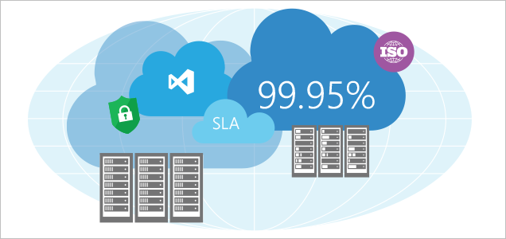
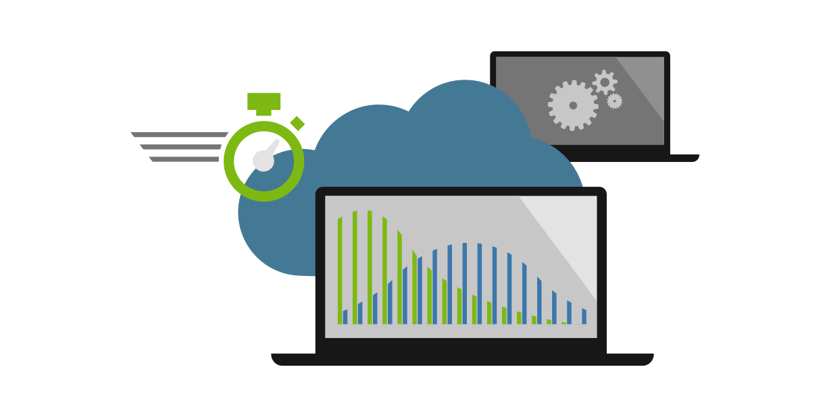
Do: Load test your application before deployment
At the absolute least, ensure that some kind of automated load testing is performed to detect a noticeable change in performance of specific, critical endpoints.
Test the application at significant load to ensure that spikes in user activity and load will not take down the application at burst times.
Test your application automatically before deployment using CI / CD Practices, the earlier you find problems, the cheaper they are to fix.
Knowing your baseline operational cost of a service on a fixed hardware stamp makes it simpler to predict how to cost and upscale the service.
Notes:
Show of hands for the audience…. All hands in the air.

Slide 47
Demo: Cloud Load Test
Let’s baseline our application’s initial performance so we know where we are starting from, let’s use the VSTS Cloud Load Test Service to do this.
Notes:
Chris R: - Setup and demonstrate the cloud-load-test feature in VSTS to baseline the following URLs
Stage 1 testing
Main Site
Only via north site at first … (devdemnwebapp.azurewebsites.net)
Only via north site at first … (devdemnfnapp.azurewebsites.net)
Stage 2 Testing – CQRS comes later
GET http://whattodoandavoidwebsite.azurewebsites.net -- Root
GET http://whattodoandavoidfnsite.azurewebsites.net/api/ArticleList -- List
GET http://whattodoandavoidfnsite.azurewebsites.net/api/ArticleGet -- Read
POST http://whattodoandavoidfnsite.azurewebsites.net/api/ArticleUpsert -- Upsert

Slide 48
Telemetry Beer, the cause of and solution to some all of ISV’s life’s problems.
Paraphrased Homer Simpson
Notes:
How are users using my service, what are they doing, how long does it take to run certain transactions.

Slide 49
Telemetry and Tracking Services
Application level - Application Insights
Operating System level - Azure (OMS) Log Analytics
Write stuff to classic log files at run time and ingest them.
Notes:
Show of hands for the audience…. All hands in the air.

Slide 50
Mind the gap Migrating to the cloud, or transitioning to SaaS charging models?
Notes:
Let’s look at some patterns and practices that can be used to mitigate the cost of building high-performance solutions.
How can you ensure maximum performance and scalability for a commercially reasonable Cost of Service?

Slide 51
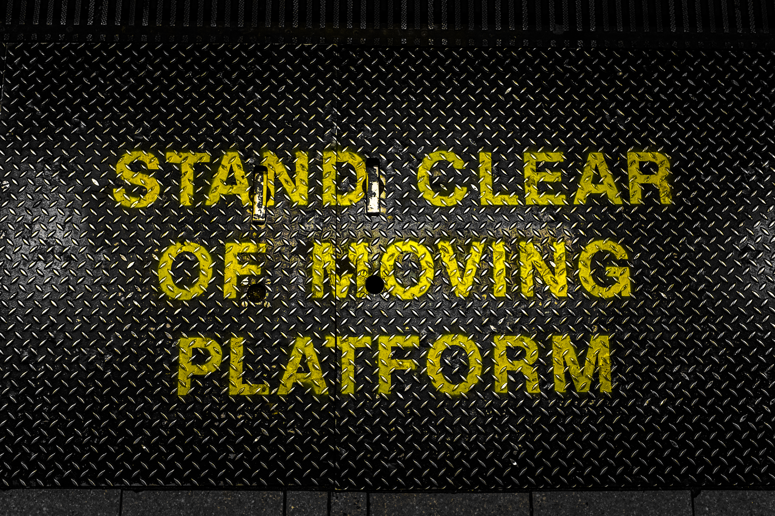
Cost Gap A gap between how you charge for your service and how you are charged for consumption of cloud resources.
Notes:
Today we are going to focus on this one :
Price :- was a fixed price (1/32) of their licence fee, but didn’t incorporate service operating costs, only a support charge.
Cost of Service is largely fixed in an IaaS environment as you are usually running VM’s.

Slide 52
Looking forward .. Utopia … We SaaSify the app We deploy it to PaaS / Serverless We change the billing model We are now ISV Leaders in SaaS But….

Slide 53

What normally happens … Where ISVs do not have a cloud or SaaS ready product, they deploy what they have and try to make it fit. Reduce customer time to return by x months. Extend ISV time to profit by x months. Add new risk of customer termination Add new risk of over-consumption (risk of under-pricing against fixed IaaS resource costs) – results in excessive cost or under-performance. Add new risk of under-consumption of resource (IaaS over-provisioning)
Notes:
So what really happened here ?
https://commons.wikimedia.org/wiki/File:Dangerous_Cliff_Edge_(2258425643).jpg
This file is licensed under the Creative Commons Attribution-Share Alike 2.0 Generic license.

Slide 54
Transitioning to SaaS - challenges Reduce customer time to return by x months. Extend ISV time to profit by x months. Add new risk of customer termination Add new risk of over-consumption (risk of under-pricing against fixed IaaS resource costs) – results in excessive cost or under-performance. Add new risk of under-consumption of resource (IaaS over-provisioning)
Notes:
So what really happened here ?
The two top items are pricing and commercial concerns, from a tech perspective there isn’t much we can do about them.
The bottom two are inside our control, it doesn’t have to be this way !
https://commons.wikimedia.org/wiki/File:Dangerous_Cliff_Edge_(2258425643).jpg
This file is licensed under the Creative Commons Attribution-Share Alike 2.0 Generic license.

Slide 55
(TCODU / TAPL) = CPT
TCODU = Service Hosting Cost + Operations and Support Staff
TAPL = Benchmark / load test result
TCOS = Total Cost of Ownership of a Deployment Unit
TAPL = Transactions at Peak Load
CPT = Cost per Transaction
Notes:
How are users using my service, what are they doing, how long does it take to run certain transactions.

Slide 56
((TCODU / TAPL)) * (1 + (Margin uplift(%) needed) = Sale Price per Transaction
TCOS = Total Cost of Ownership of a Deployment Unit
TAPL = Transactions at Peak Load
CPT = Cost per Transaction
Notes:
How are users using my service, what are they doing, how long does it take to run certain transactions.

Slide 57
Now your pricing can be calculated via selling transactions in a serverless pricing model (with a direct link from your delivered customer value to the paid price). Or by selling a fixed capacity by selling multiples of Deployment Units to support x users.
Notes:
How are users using my service, what are they doing, how long does it take to run certain transactions.

Slide 58
Now use autoscaling and / or Serverless to keep that TAPL value constant
TCOS = Total Cost of Ownership of a Deployment Unit
TAPL = Transactions at Peak Load
CPT = Cost per Transaction
Notes:
How are users using my service, what are they doing, how long does it take to run certain transactions.

Slide 59
Serverless What about these Azure Functions?
Notes:
Let’s look at some patterns and practices that can be used to mitigate the cost of building high-performance solutions.
How can you ensure maximum performance and scalability for a commercially reasonable Cost of Service?

Slide 60
Serverless = You are not being charged for the runtime cost of a server directly. #1
The risk of under consumption (and hence wastage) of provisioned service transfers to the provider (Microsoft)
and away from the customer.
Don’t consume: Zero charge – The origin and barrier
to entry £Zero – or better than zero on ‘Consumption priced’ services that have a free tier.
Consume: Predictable charge so you can calculate a margin.

Slide 61
Serverless = You are not being charged for the runtime cost of a server directly. #2
The risk of over consumption (and hence poor performance) of provisioned service transfers to the provider (Microsoft)
and away from the customer.
Over consume: Pass the additional consumed cost on to your end-consumer of the service as a usage charge.

Slide 62
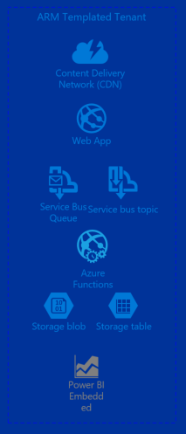

Some Services in Azure that can run on solely Consumption based pricing
Azure Functions
Azure Storage
Azure CDN
Azure Service Bus
Azure Event Hubs
Power BI Embedded
+ Many, many more
Notes:
It is possible to build sites and apps that run only on these services, to leverage consumption based pricing and build high-performance sites and apps that scale linearly and predictably, with costs that scale linearly and predictably.

Slide 63
Serverless: What’s the benefit for me?
Predictable, per-transaction billing
Mass scale out with no incremental cost of provisioning
Cost origin that starts at zero
Free service whilst consumption is reduced or minimal
Notes:
Billed by runtime of transactions, pay truly upon usage, not ‘near to’ estimated / provisioned usage.
Forget about how many servers you need, only care about how many you transactions that want to charge for.
Want to bootstrap a service quickly, with minimal investment – serverless based plans are disposable.
Only pay for what you actually consume, let Microsoft take the risk and revenue hit of provisioning and reserving a massive pool of server hardware.

Slide 64
Demo: Azure Functions
Let’s build an Azure Function that does something useful to us and make it scale dynamically.
Notes:
Chris R: - Setup and demonstrate the cloud-load-test feature in VSTS to baseline the following URLs
Stage 1 testing
Main Site
Only via north site at first … (devdemnwebapp.azurewebsites.net)
Only via north site at first … (devdemnfnapp.azurewebsites.net)
Stage 2 Testing – CQRS comes later
GET http://whattodoandavoidwebsite.azurewebsites.net -- Root
GET http://whattodoandavoidfnsite.azurewebsites.net/api/ArticleList -- List
GET http://whattodoandavoidfnsite.azurewebsites.net/api/ArticleGet -- Read
POST http://whattodoandavoidfnsite.azurewebsites.net/api/ArticleUpsert -- Upsert

Slide 65
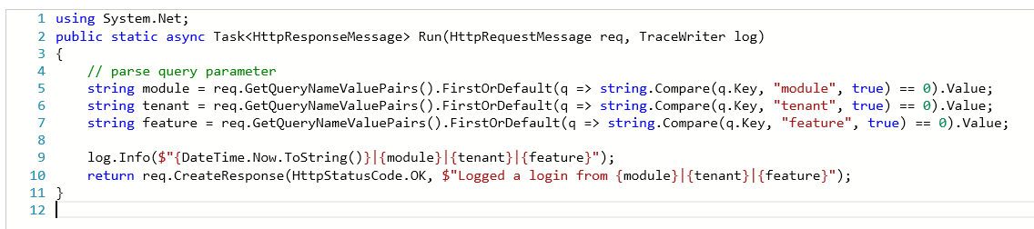
My Function code C#
\BillingTelemetry\Run.csx

Slide 66
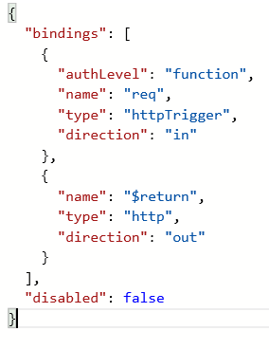
My Function code - PowerShell
\BillingTelemetry\run.ps1
\BillingTelemetry\function.json

Slide 67
Do: Consider licences of additional software
Cloud or on-premise licences with Cloud-usage rights.
Verify the use of each license is appropriate - for example SQL Server in Azure pricing vs. bring your own SQL Server from EA - typically EA pricing discounts would mean cheaper SQL Server for a 24x7 running SQL VM than Azure pricing.
Check Runtime Licencing that is per-core or per-server.
Per-core licencing is more flexible in auto-scale environments than per-server licences.
As you can licence a smaller number of cores for a reduced cost, culminating in an auto-scale cost of 1 core when the service is idle.

Slide 68
“What about the stuff to avoid, i.e. what not to do.”
Notes:
Why this quote, the truth is that most of these costings are soft, and typically performed in a finger in the air style methodology.
Here’s a sensible way to estimate and predict, AND minimize cost.
Throughput measurements and load testing, vs size estimates.
End-User telemetry to track and manage server load vs the type of transactions that are occurring.

Slide 69
What to avoid in Cost Management
lack of cost ownership and reporting
Many Customers do not have someone in place to monitor cost on Azure.
This should be done at a level appropriate for the organization, e.g. project or team level.
Over-provisioning of resources causing wastage
Some customers over-provisioned resources, even though such sizing was not required.
Customers should perform load testing, and be aware of the necessary limits of their service.
payments made by corporate credit card
Some customers are managing their Azure payments via credit card.
The customer could be missing out on a number of discounts and enhanced support offerings via their Enterprise Agreement.
dev/test environments not de-provisioned
A number of customers have not de-provisioned their dev/test when not required.
To reduce cost, customers should consider scaling down / shutting off their dev/test environments when not in use.
Notes:
https://azure.microsoft.com/en-us/documentation/services/automation/
https://azure.microsoft.com/en-gb/documentation/articles/guidance-compute-3-tier-vm/
Talk more about credit card and purchasing on the next page.

Slide 70
What to avoid in Efficiency
Over complex solution design
In a number of scenarios, customers have over-engineered their solution, to solve the problem at hand. This has typically introduced unnecessary cost and risk/complexity within the solution.
Take an external view when working with the customer, and challenge their approach. Could they be using an alternate approach, which would be simpler and reduce their end-cost?
lack of clarity on non-functional requirements
Some solutions have been over-engineered for the level of SLA that they require, or they have an SLA which is impossible with their solution architecture. This can result in either excessive risk, or cost.
Customers should ensure that they are fully aware of their requirements in advance of design. Strongly challenge them on this point – How can they build a solution meeting availability , scalability and cost requirements, if they are undetermined?
Notes:
https://azure.microsoft.com/en-us/documentation/articles/architecture-overview/
http://aka.ms/azblueprints
https://www.infoq.com/articles/non-functional-requirements-in-architectural-decision-making

Slide 71

Evaluation Forms
We hope you have enjoyed the morning, we have one ask of you.
Please out your evaluation forms to give us feedback on what we did right and how we can improve the sessions next time.
Your feedback is critical to making more of these sessions a success !

Slide 72
Links and Downloads
Free Cloud Design Patterns ebook
http://www.microsoft.com/en-us/download/details.aspx?id=42026
Cloud Design Patterns Poster
https://azure.microsoft.com/en-us/documentation/infographics/cloud-design-patterns/
This session - Demos and Presentation Repository
https://github.com/dxuk/AzureWorkshops/blob/master/BestPractices-1stSept2016/Best%20Practices%20-%20Scalability%2C%20Availability%2C%20Performance%20and%20Resilience.pptx

Slide 73
Lunch
Please put any questions up on the site for our Group Discussion Track after lunch !

Slide 74
Chalk ‘n’ Talk
Interactive Discussion

